Slide 1


Submitted by
Biju B
Godwin N
Ananthu P Nair
St. Xavier's Catholic College of Engineering
Department of Electronic and Communication Engineering
April 2023

Slide 2


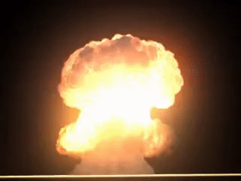


PROBLEM STATEMENT
A ILO survey suggest that more than 100 of miners die every year due to hazardous gas.
These events are caused due to lack observation of the monitoring unit present outside.
Currently Zigbee or WIFI is used to transmit the data which has limited range and high power consumption.

Slide 3



Alerts the miner in case of hazardous gas leakage.
SOLUTION
Device is used to get rid of the lack of observation & communication between the miners
Sends real time data of sensor readings to the monitoring unit

Slide 4


The use of LoRa
Attached &
Noise reduction ear plug
Attached Specs
INNOVATION

Slide 5



Prototype
LoRa
Existing Mining Helmet
RESEARCH DONE SO FAR

Slide 6




MQ-2
Technical Details
Arduino
Warning
Warning
MQ-136
LoRa Transmitter
Battery
LED Light
Buzzer
MQ-135
Temperature & Humidity Sensor
MQ-7
LoRa
Receiver
NODEMCU
Warning

Slide 7



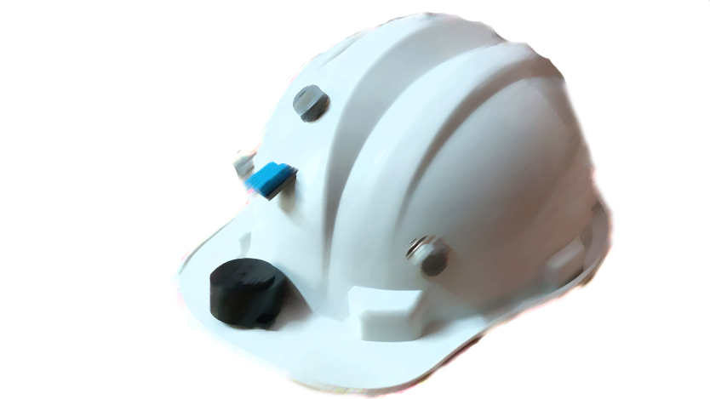
Serial No: | Walsh Hat | Hexagon Mining | Other smart helmets (only project models)
Features | Attached spectacles | Separate spectacles | No attached spectacles
Technology | Lora | - | Zigbee
Transmitted distance | Upto 10km | - | Upto100m
Ear plugs(Noise cancellation) | Yes | No | No
There are many mining helmets with gas sensors and wireless transmission but they do not have LoRa communication channel and low powered module
COMPETITIVE ADVANGTAGE
Source : Hexagon

Slide 8


REVENUE MODEL
Direct sale with the mining companies ( More than 94,000 mines are present in India, which delivers huge profit )
B to B
B to C
Online platform
₹ 2500
Service the product

Slide 9


Go - To Market
strategic
Awareness programs
Ads
Contract with mining companies
Online Platform
Sense surrounding better than you

Slide 10

Patent Search Result
Type of entity
private limited company
IPR(intellectual property right
patent
,industrial registration

Slide 11
Reference:
https://ieeexplore.ieee.org/document/9807899
https://www.rcrwireless.com/20160819/fundamentals/lora-lorawan-tag31-tag99
https://ieeexplore.ieee.org/document/8554698
Xiaoliang Wang, Xinyuan Xu, Xiaodan Wang, Zhigang Zhao, and Changqing Yan, “Design and Implementation of Intelligent Miner Helmet Based on ZigBee Wireless Sensor Network,” Journal of Sensors, vol. 2016, Article ID 7696261, 12 pages, 2016.
X. Qiu, Z. Yu, L. Wang, S. Li, “The Design of Intelligent Helmet for Coal Miners Based on ZigBee Technology,” International Conference on Computer Application and System Modeling (ICCASM 2010), Taiyuan, China, vol. 1, pp. V1-601-V1-604, 2010.

Slide 12

THANK YOU

